Slide 1



Microsoft Power BI Data Analyst (PL-300)
Day 2: May 24, 2025

Slide 2
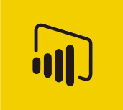
Microsoft Power BI Data Analyst (PL-300)
Learning Objective –
Prepare the data
Model the data
Visualize and analyze the data
Manage and secure Power BI

Slide 3
Course Contents - Prepare the Data (25–30%)
Get or connect to data
Identify and connect to data sources or a shared semantic model
Change data source settings, including credentials and privacy levels
Choose between Direct Query and Import
Create and modify parameters
Profile and clean the data
Evaluate data, including data statistics and column properties
Resolve inconsistencies, unexpected or null values, and data quality issues
Resolve data import errors
Transform and load the data
Select appropriate column data types
Create and transform columns
Group and aggregate rows
Pivot, unpivot, and transpose data
Convert semi-structured data to a table
Create fact tables and dimension tables
Identify when to use reference or duplicate queries and the resulting impact
Merge and append queries
Identify and create appropriate keys for relationships
Configure data loading for queries

Slide 4
Course Contents - Model the Data (25–30%)
Design and implement a data model
Configure table and column properties
Implement role-playing dimensions
Define a relationship's cardinality and cross-filter direction
Create a common date table
Identify use cases for calculated columns and calculated tables
Optimize model performance
Improve performance by identifying and removing unnecessary rows and columns
Identify poorly performing measures, relationships, and visuals by using Performance Analyzer and DAX query view
Improve performance by reducing granularity
Create model calculations by using DAX
Create single aggregation measures
Use the CALCULATE function
Implement time intelligence measures
Use basic statistical functions
Create semi-additive measures
Create a measure by using quick measures
Create calculated tables or columns
Create calculation groups

Slide 5
Course Contents - Visualize and Analyse the Data (25–30%)
Create reports
Select an appropriate visual
Format and configure visuals
Apply and customize a theme
Apply conditional formatting
Apply slicing and filtering
Configure the report page
Choose when to use a paginated report
Create visual calculations by using DAX
Identify patterns and trends
Use the Analyze feature in Power BI
Use grouping, binning, and clustering
Use AI visuals
Use reference lines, error bars, and forecasting
Detect outliers and anomalies
Enhance reports for usability and storytelling
Configure bookmarks
Create custom tooltips
Edit and configure interactions between visuals
Configure navigation for a report
Apply sorting to visuals
Configure sync slicers
Group and layer visuals by using the Selection pane
Configure drill through navigation
Configure export settings
Design reports for mobile devices
Enable personalized visuals in a report
Design and configure Power BI reports for accessibility
Configure automatic page refresh

Slide 6
Course Contents - Manage and Secure Power BI (15–20%)
Create and manage workspaces and assets
Create and configure a workspace
Configure and update a workspace app
Publish, import, or update items in a workspace
Create dashboards
Choose a distribution method
Configure subscriptions and data alerts
Promote or certify Power BI content
Identify when a gateway is required
Configure a semantic model scheduled refresh
Secure and govern Power BI items
Assign workspace roles
Configure item-level access
Configure access to semantic models
Implement row-level security roles
Configure row-level security group membership
Apply sensitivity labels

Slide 7
Overview of Data Analysis
Data analysis is the process of cleaning, transforming, and modelling data to extract meaningful insights that support decision-making.
Importance of Data Analysis:
Enables storytelling through data to support decisions.
Critical for businesses to remain competitive and efficient.
Helps in evaluating customer behaviour, market trends, and business impact.
Requires trusted, clean, and well-structured data.
Core Types of Data Analytics:
Descriptive Analytics – Explains what happened using historical data (e.g., sales reports, KPIs).
Diagnostic Analytics – Explains why it happened by investigating causes behind anomalies.
Predictive Analytics – Forecasts what is likely to happen using trends and statistical models.
Prescriptive Analytics – Recommends what actions to take to achieve goals, using AI and ML.
Cognitive Analytics – Uses AI to simulate human thought, drawing insights from unstructured data like text and speech.

Slide 8
Tasks of a Data Analyst
Prepare: Clean and transform raw data for analysis while ensuring data integrity and privacy.
Model: Build relationships and calculations to create efficient data models.
Visualize: Design clear, interactive reports that tell a data-driven story.
Analyze: Interpret data to find patterns, trends, and actionable insights.
Manage: Share, secure, and maintain reports and models to support collaboration and trust.

Slide 9
Introduction to Power BI
A complete reporting solution for data preparation, visualization, distribution, and management.
Scales from simple to complex reports with multiple data sources and models.
Enables creation of interactive, visually appealing reports for teams or entire organizations.
Acts as a powerful analytics and decision-making engine.
Essential for data analysts, but valuable for all data professionals to present insights effectively.

Slide 10
Key Components & Workflow
Power BI has three components: Desktop (development), Service (online management), and Mobile (viewing).
Power BI Desktop is used to connect, model, and visualize data.
Reports are published to the Power BI Service for sharing and collaboration.
Power BI Mobile delivers mobile-optimized report views.
Common workflow: Connect → Transform → Visualize → Publish → Distribute.
Dashboards and apps in the Power BI Service help organize and deliver insights effectively.
Power BI Desktop
Power BI Service
Power BI Mobile

Slide 11
Building Blocks of Power BI
Power BI is built on semantic models and visualizations.
A semantic model includes data sources, transformations, relationships, and calculations.
Use Power BI Desktop to build interactive reports using visuals on the canvas.
Power BI is low-code—simply drag and drop fields to create visuals.
Visuals can be interactive and enable drill through and filtering.
In the Power BI Service, pin visuals to a one-page dashboard for high-level summaries.
Dashboards guide users to deeper insights in the full report.
Visualizations
Reports
Dashboards
Tiles
Datasets

Slide 12
Power BI Installation
Open Microsoft Store (Windows 10/11)
Search for "Power BI Desktop"
Click Install (Free)
Or Download from Official Website
Go to: https://powerbi.microsoft.com
Navigate to Products > Power BI Desktop
Click Download Free
Choose language and download the .exe file
Run the Installer
Double-click the downloaded .exe file
Follow on-screen instructions to install
Launch Power BI Desktop
After installation, open the app from the Start menu
Sign in with your work/school Microsoft account if prompted

Slide 13
Power BI Components
Power BI Desktop
Power Query
Power Pivot
Power View
- Perform data transformation
- Store the results in an
excel file or in a Power Pivot model
- Perform data modeling
- Build a schema,
relationships,
- Create user defined fields
- Connect to different data sources
- Create Views
- Add interactivity

Slide 14
Knowledge Check
Q. Power BI helps with which of the following business processes?
Notifying users when a SharePoint list item has changed.
Generating an approval.
Analyzing and displaying data.

Slide 15
Knowledge Check
Q. Which is a way that Power BI can help you effectively leverage your data?
Analyze sales data to better allocate resources and place orders, optimizing operations.
Analyze customer data to better target and promote specific items to specific customers.
All of the above.

Slide 16
Knowledge Check
Q. What are the three modalities of Power BI designed to let people create, share, and consume business insights in the way that serves them, or their role, most effectively?
Desktop, service, and Mobile apps.
Tiles, visualizations, and dashboards.
Reports, dashboards, and tiles.

Slide 17
Power BI Interface

Slide 18
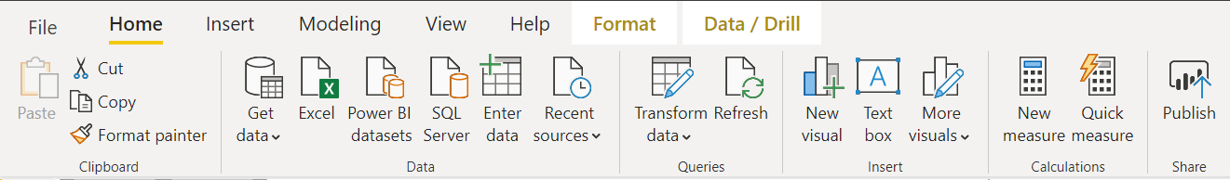
Home Tab - Data Ribbon
Data Connection options
Get Data window, allows to scroll through the list of All data sources

Slide 19
Home Tab - Queries Ribbon
Data Transformation and edit queries
Provides access to Power Query Editor.
It helps shaping data.
Shaping can mean transforming the data, such as renaming columns or tables, removing rows or columns, or changing data types

Slide 20
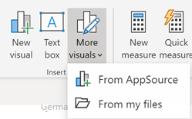
Home Tab - Insert Ribbon
Helps add new visuals
Custom visuals are hosted in AppSource and can be accessed by pressing the “More visuals” dropdown and selecting “From AppSource”

Slide 21
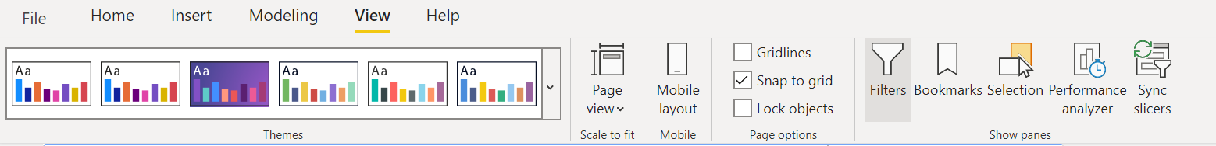
View Tab - Themes Ribbon
Themes ribbon displays themes in a gallery making it more easily to see what colours will be applied to report.
Also allows user to set custom themes

Slide 22
View Tab
Various Page visibility options and hide/show panes on report view tab

Slide 23
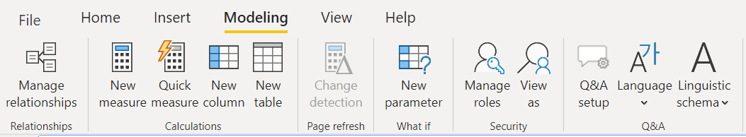
Modelling Tab - Relationships Ribbon
Opens Data Model view
Relationships between tables can be created and managed here.

Slide 24
Modelling Tab - Calculations Ribbon
Allows user to create new fields by writing DAX expressions.

Slide 25
Report View – Data View – Model View

Slide 26
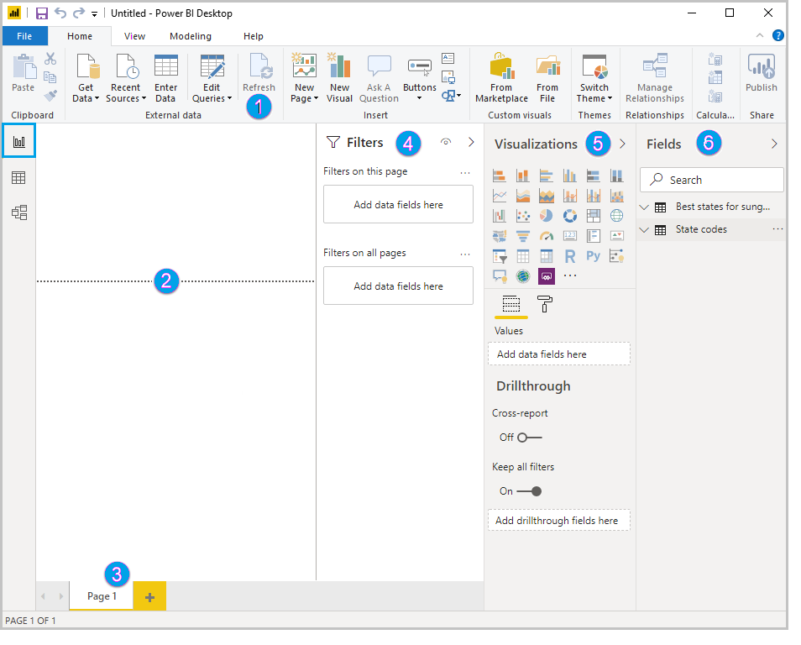
Report View
In Power BI Desktop Report view, user can build visualizations and reports.
The ribbon at the top, which displays common tasks associated with reports and visualizations.
The canvas area in the middle, where visualizations are created and arranged.
The pages tab area at the bottom, which lets you select or add report pages.
The Filters pane, where you can filter data visualizations.
The Visualizations pane, where you can add, change, or customize visualizations, and apply drill through.
The Fields pane, which shows the available fields in your queries. You can drag these fields onto the canvas, the Filters pane, or the Visualizations pane to create or modify visualizations.
1
4
5
6
2
3

Slide 27
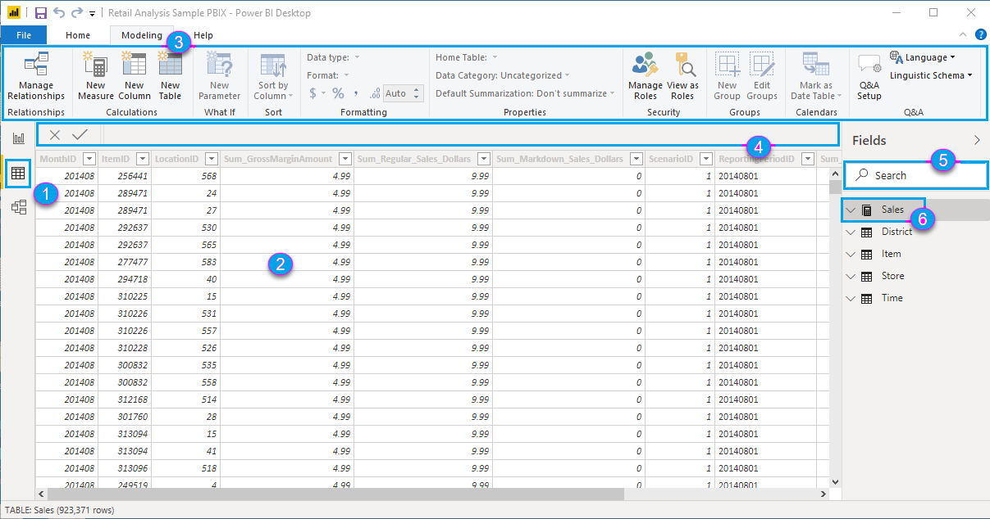
Data View
Data View in Power BI shows a tabular view of your imported data, allowing you to inspect, explore, and verify the dataset before building reports. It helps you see the raw data and understand its structure.
Refer to the figure on the left -
Data view icon - Select this icon to enter Data view.
Data Grid - This area shows the selected table and all columns and rows in it. Columns hidden from Report view are greyed out. Right-click on a column for options.
Modeling ribbon - Tab to manage relationships, create calculations, change data type, format, data category for a column.
Formula bar - Enter Data Analysis Expression (DAX) formulas for Measures and Calculated columns.
Search - Search for a table or column in model.
Fields list - Select a table or column to view in the data grid.

Slide 28
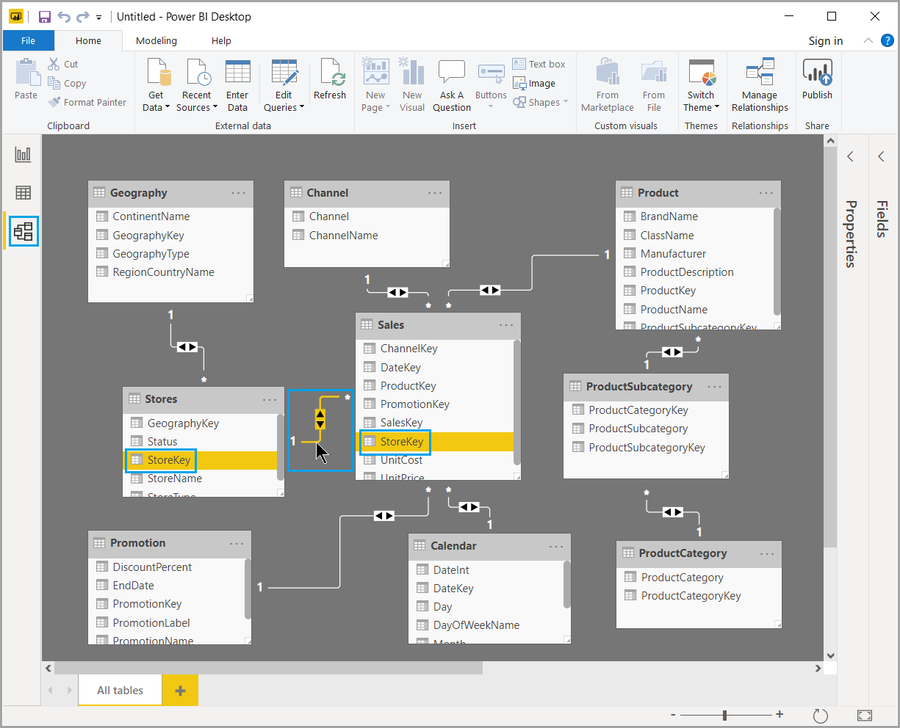
Model View
Model view shows all of the tables, columns, and relationships in data model.
This view can be especially helpful when model has complex relationships between many tables.
Select the Model icon near the side of the window to see a view of the existing model.

Slide 29
Connecting to Data

Slide 30
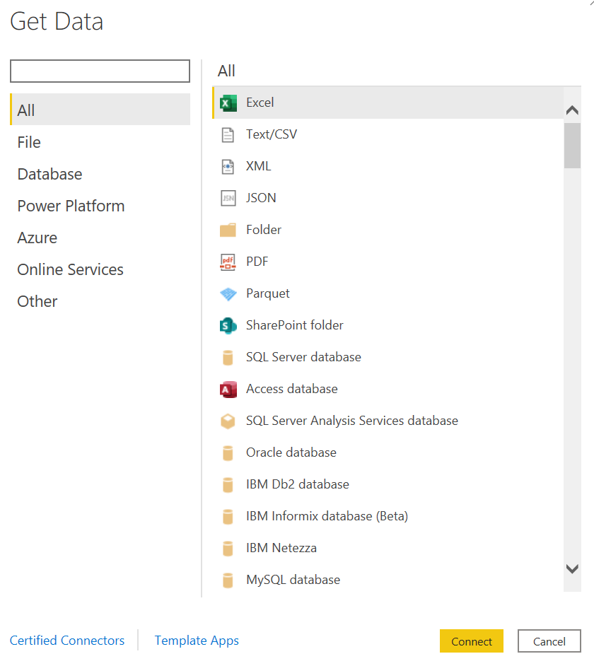
Connect to Data Source
Home Tab > Data Ribbon> Get data
Select the appropriate data connection
Enter credentials (if required)
Load data

Slide 31
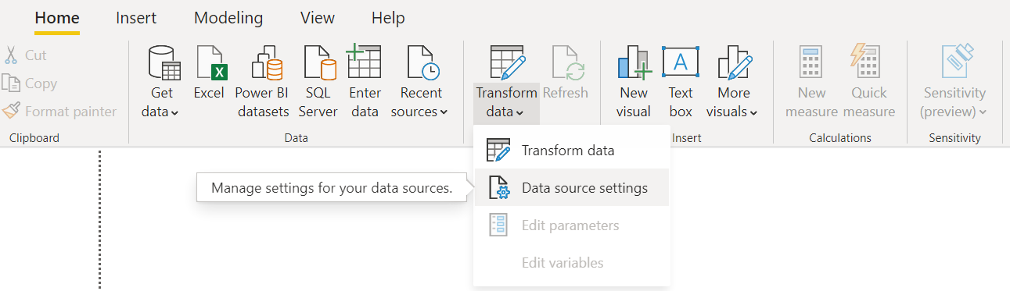
Change to Data Source Settings
Home Tab > Queries Ribbon> Transform Data > Data source settings
Assign new data connection

Slide 32
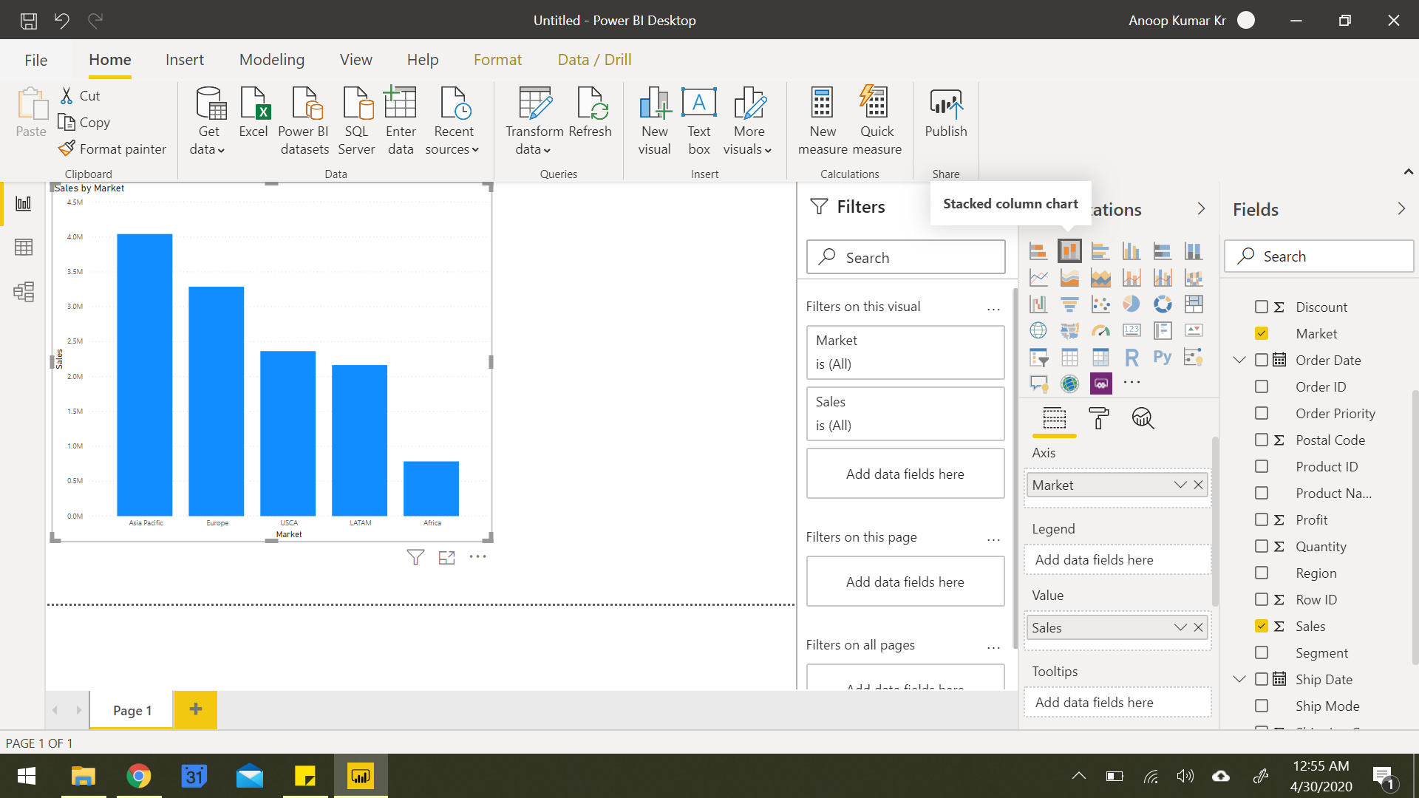
Build a Visualization
1. Understand Your Fields
In the Fields pane (right side), review your tables and columns.
Identify dimensions (categories like “Department”) and measures (quantities like “Sales” or “Salary”).
2. Choose Your Visualization
In Report View (center canvas):
Go to the Visualizations pane.
Click on a chart type (e.g., bar, line, pie, table, etc.).
A blank chart will appear on the canvas.

Slide 33
Build a Visualization
3. Drag and Drop Fields
Drag fields from the Fields pane to the appropriate areas in the Visualizations pane:
Axis / Legend / Category: For dimensions (e.g., Month, Department).
Values: For numerical data (e.g., Sales, Quantity).
Filters / Tooltips: For filtering or showing additional data on hover.
4. Format Your Chart
Use the Format tab (paint roller icon):
Adjust titles, colors, labels, gridlines, data labels, etc.
Toggle on/off legends, tooltips, and other elements.

Slide 34
Exercise
Connect to file Employees.xlsx file
Load data from Employee sheet
Create Visualizations:
Card Chart: Total number of Employees
Bar Chart:. Average Salary by Department.
Line Chart: Number of employees joined per year.
Pie Chart: Employee count by department
Slicer: Gender
Q&A visual
Demo - Customizing theme, formatting visuals, formatting pages, drill up/down filters, edit interactions

Slide 35
Power BI Filters: What We’ve Learned So Far –
Cross-Filtering / Cross-Highlighting – Occurs when selecting a data point in one visual filters or highlights data in another.
Edit Interactions – A feature that lets you control how one visual affects others when selected (filter, highlight, or do nothing). Found under the Format > Edit Interactions toolbar option.
Slicers – Interactive on-page filters users can click to filter multiple visuals at once.
Drill through Filters – Allow users to right-click a data point and navigate to a detail page with context carried over.
Visual-Level Filters – Apply to a single visual only. Other visuals are unaffected.
Page-Level Filters – Affect all visuals on the current report page.
Report-Level Filters – Apply across all report pages, useful for global filters like region or time period.

Slide 36
Power BI Styling Tools: What We’ve Learned So Far –
Customizing Theme
Themes control colors, fonts, backgrounds, and default styles for all visuals.
Access via: View > Themes
Formatting Visuals
Each visual can be individually styled using the Format pane.
Common options include:
Title: Text, size, alignment, and font.
Data labels: Show values on charts.
Legend: Show/hide, position, font, color.
Colors: Change bar/line/segment colors.
Tooltips: Customize hover-over info.
Borders & Backgrounds: Add emphasis or group visuals visually.
Formatting Pages
Customize the layout and behavior of entire report pages.
Found under the Format > Page information or by clicking the empty canvas:
Page size: Switch between default, 16:9, letter, or custom dimensions.
Backgrounds: Add colors or images to the canvas (e.g., branded templates).
Canvas settings: Enable gridlines or snap-to-grid for visual alignment.

Slide 37
Introduction to Power Query Editor

Slide 38
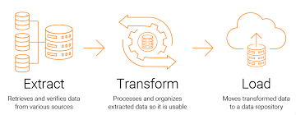
Overview of Power Query Editor
Tool for connecting, transforming, and shaping data.
Available in Power BI, Excel, and other Microsoft tools.
Generates M code automatically based on actions.
Interface split into Query Pane, Data Preview, and Applied Steps.
Data Source Connectivity
Connect to multiple sources: Excel, CSV, SQL Server, Web, APIs, SharePoint, etc.
Combine multiple queries using merge or append.
Use parameters and functions for dynamic data loads

Slide 39
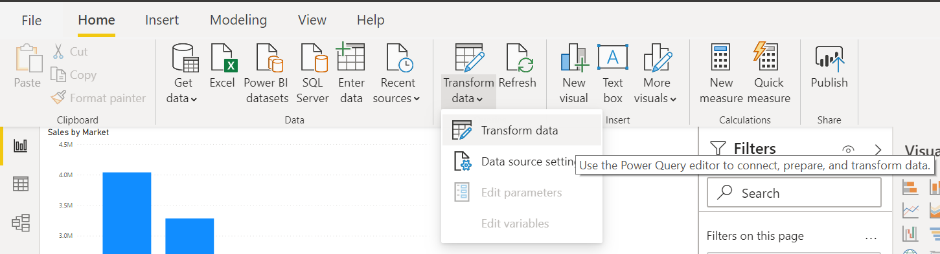
Launch Power Query Editor
Home Tab > Queries Ribbon > Transform data

Slide 40
Data Transformation Tools
Definition: Data transformation is the process of converting data from its raw form into a structured, usable format by applying operations like cleaning, reshaping, and enriching.
Purpose: It ensures data is consistent, accurate, and ready for analysis or reporting by correcting errors, standardizing formats, and structuring datasets.
Types of Transformations: Includes filtering, sorting, aggregating, splitting or merging columns, changing data types, and removing duplicates.
Use Case - Data Cleaning:
Fixing missing or incorrect values, removing duplicates, and standardizing formats to improve data quality.
Use Case - Data Integration:
Combining data from multiple sources (e.g., databases, spreadsheets) into a unified dataset for comprehensive analysis.
Use Case - Preparing Data for Visualization:
Transforming data to fit the needs of charts and dashboards, such as grouping or pivoting data for better insights.

Slide 41
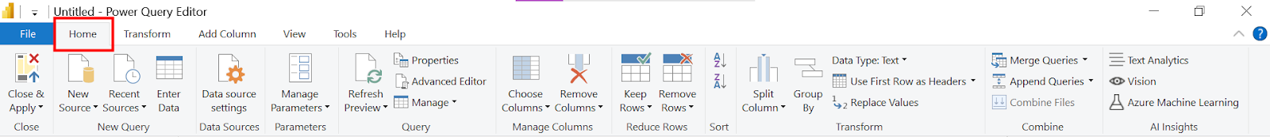
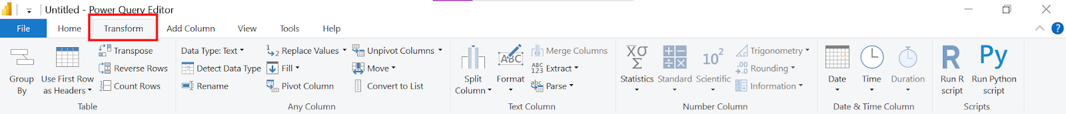
Power Query Editor – Interface
Home Tab - essential commands for data import, transformation, and query management.
Transform Tab - Contains tools to modify and clean your data, like changing data types, filtering, and splitting columns.

Slide 42
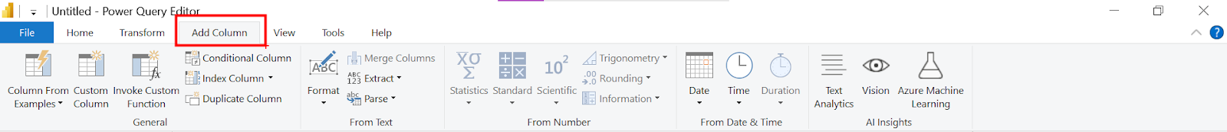
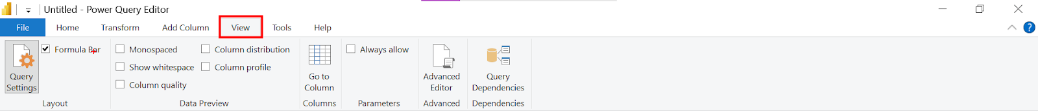
Power Query Editor – Interface
Add Column Tab - Allows you to create new columns based on calculations, conditions, or custom formulas.
View Tab - Offers options to manage the Power Query interface, such as viewing query dependencies, formula bar, and layout settings.

Slide 43
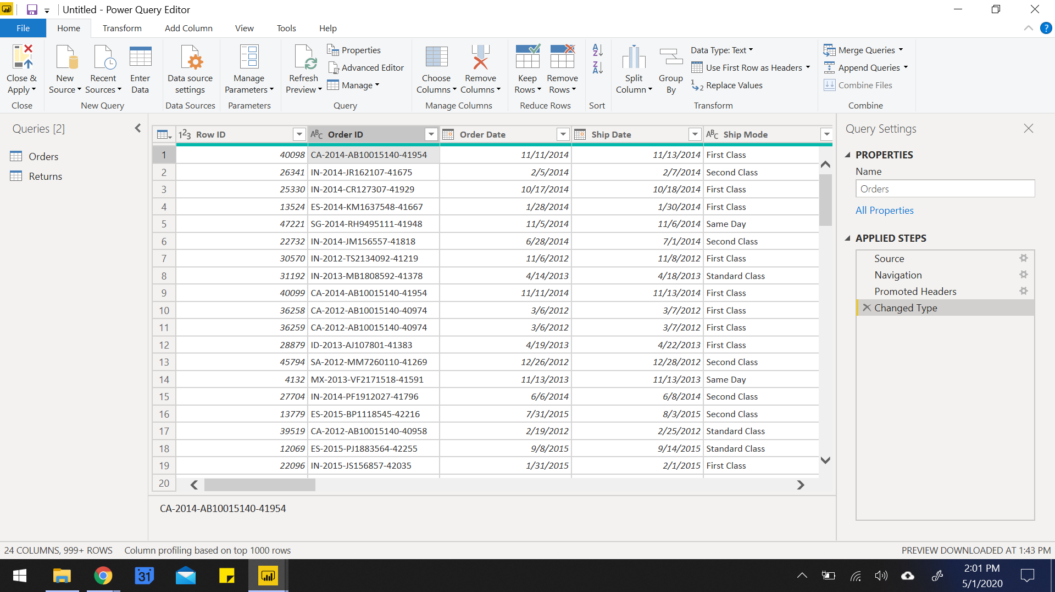
Power Query Editor – Interface
List of queries
Data preview of the selected sheet gets loaded

Slide 44
Power Query Editor – Interface
Renaming query
List of all the transformation steps applied on the data

Slide 45
Exercises
Example : Use GDP dataset for following examples –
Connect to file Country GDP by Year.csv
Convert to unpivot the columns to analyze GDP over the years.

Slide 46
Combining Tables with Append Queries
What is Append?
Appends = Stack rows from one or more tables into a single table.
When to Use It:
Combining monthly files, regional sales reports, or similar structured tables.
All tables should have matching columns (same names and order preferred).
How to Do It:
Go to Home > Append Queries (or "Append Queries as New").
Select the two or more tables you want to combine.
Result: One long table with all rows stacked.
⚠️ Tip: Columns that don’t match may create nulls or extra columns.

Slide 47
Understanding M Code in Power BI
Key Concepts:
M stands for Mashup — a functional language used in Power Query.
Automatically generated behind the scenes as you apply transformations.
Every step in Applied Steps panel = 1 line of M code.
Tip: You don’t need to memorize M code—but understanding the logic gives you more control.
Use Case: Helpful for advanced logic, debugging issues, or editing multiple steps at once.
Examples of Common M Functions:
Task | M Code Example
Rename a column | Table.RenameColumns(...)
Change data type | Table.TransformColumnTypes(...)
Filter rows | Table.SelectRows(...)
Add custom column | Table.AddColumn(...)
Merge queries | Table.NestedJoin(...)

Slide 48
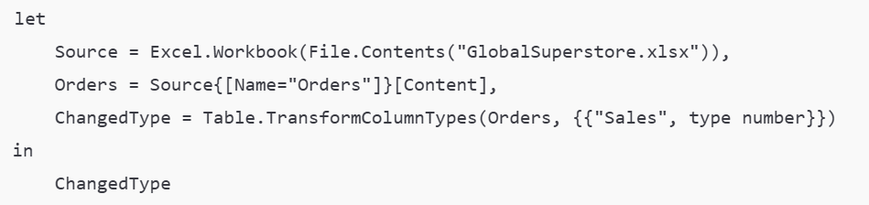
Advanced Editor in Power Query
Power BI > Transform Data > Power Query Editor > Home > Advanced Editor
What You See:
Full script of all transformations written in M code.
Starts with let, ends with in.
Easy to copy/paste, reuse logic, or tweak steps globally.
Why Use Advanced Editor?
Combine/modify steps efficiently.
Reuse query logic across projects.
Insert comments using //.
⚠️ Tip: Always double-check syntax. One error can break the whole query.
Example Template:

Slide 49
Exercises
Example: Use Stock Data for following examples –
Create a chart to see the monthly change in volumes of stocks, beginning of 2010 to the end of 2014. Which two consecutive months saw the least fluctuation in increase or decrease?
Compare avg open value for all the company across 2010 to 2014. Which company saw a drop in value in 2013?
Create a table chart showing the sum of Volume per Company per Year. What was the total volume for Apple in 2013 and the total volume for Apple for 2010 through 2014, respectively?

Slide 50
Combining Tables with Merge Queries
What is Merge?
Merges = Join data from two tables using a common key (like VLOOKUP).
When to Use It:
Adding customer info to orders.
Joining product master with sales data.
Enriching data from reference tables.
How to Do It:
Go to Home > Merge Queries (or "Merge Queries as New").
Select the two tables and matching columns (keys).
Choose Join Type:
Left Join (default): All rows from the first table, matched from the second.
Inner Join: Only matching rows from both.
Full Outer, Right Outer, Anti Joins, etc.
⚠️ Tip: After merging, click the expand icon (🔽) to select which columns to add from the second table.

Slide 51
Common Transformations in Power Query
Transformation | Description
First Row as Headers | Promotes the first row to be column headers.
Remove Columns | Delete unnecessary columns to clean the dataset.
Change Data Type | Convert columns to appropriate data types (e.g., date, number, text).
Split Column | Break a column by delimiter (e.g., comma, space) or number of characters.
Merge Columns | Combine two or more columns into a single column with a separator.
Trim/Clean Text | Remove extra spaces or non-printable characters from text data.
Fill Up/Down | Fill null values using values from above or below rows.
Replace Values | Substitute specific values with new ones (e.g., fix typos, unify names).
Transformation | Description
Date Transformation | Extract year, month, day, quarter, or calculate durations from date columns.
Text Transformation | Change case (upper/lower/proper), extract substrings, or format strings.
Add Conditional Column | Create logic-based columns (e.g., "High" if Sales > 500, else "Low").
Add Custom Column | Write simple formulas using M to create new fields.
Group By | Aggregate data (sum, average, count) by categories or IDs.
Column Profiling | View data quality, column distribution, and value statistics.
Transpose Table | Swap rows and columns for better alignment or reshaping data.
Unpivot Columns | Convert wide-format data to long format for analysis.

Slide 52
Exercises
Example : Global Superstore Dataset –
Connect to orders file using folder option
Connect to global superstore.xlsx and import all tables
Merge orders and returns tables
Model the remaining table using relationship

Slide 53
Examples – Global Super Store Dataset
Ex. How many customers are registered to our portal?
Ex. How many orders were placed?
Ex. How many products delivered?
Ex. How many orders were placed with only 1 product?
Ex. How many customers have never placed a single order?
Ex. To how many countries are products delivered?
Ex. How many Products are there in our inventory?
Ex. The Customer Name column is in the format "FirstName LastName". How would you split this into two columns?
Ex. Create a new column that labels a sale as "High" if the Sales amount is greater than $500, and "Low" otherwise.
Ex. Generate Age-Groups using “Column from Examples”

Slide 54
Merge vs Append in Power Query
Feature | Merge | Append
Purpose | Combine tables side-by-side using a key | Stack tables on top of each other
Structure | Tables may have different columns | Tables should have same columns/structure
Use Case | Lookups, enrich with customer/product data | Combine monthly, regional, or similar data sets
Action | Joins based on a common field (e.g., ID) | Adds rows from one table to another
Example | Add Customer Name to Order Data | Combine Jan, Feb, Mar sales tables
⚠️ Tip: Think of Merge as a VLOOKUP (horizontal) and Append as stacking files (vertical)

Slide 55
Knowledge Check
Q. What is a risk of having null values in a numeric column?
That function SUM of data will be incorrect.
That function MAX of data will be incorrect.
That function AVERAGE of data will be incorrect.

Slide 56
Knowledge Check
Q. If you have two queries that have different data but the same column headers, and you want to combine both tables into one query with all the combined rows, which operation should you perform?
Append
Merge
Combine Column

Slide 57
Knowledge Check
Q. Which of the following selections are not best practices for naming conventions in Power BI?
Rename columns to have spaces in them.
Abbreviate column names.
Replace values that have integers with human readable results.

Slide 58
Data Modelling

Slide 59

Introduction to Data Modelling
Data Modelling in Power BI is the process of connecting, organizing, and structuring data from multiple sources using relationships, calculated fields, and hierarchies to enable efficient analysis and reporting. It helps create a logical view of data that supports meaningful visualizations and insights.
A good data model offers the following benefits:
Data exploration is faster.
Aggregations are simpler to build.
Reports are more accurate.
Writing reports takes less time.
Reports are easier to maintain in the future.

Slide 60
Key-Characteristics of Data Model
Relationships: Power BI uses relationships to connect tables, allowing users to create reports across multiple data sources without duplicating data.
Star Schema: It's best practice to model data using a star schema — fact tables at the center surrounded by dimension tables — to improve performance and clarity.
Primary and Foreign Keys: Relationships are defined using primary and foreign keys; ensure each dimension table has a unique key to maintain data integrity.
Cardinality and Cross Filter Direction: Define relationship cardinality (one-to-one, one-to-many, many-to-one) and choose appropriate filter directions (single or both) to control data flow.
Calculated Columns and Measures: Use DAX to create calculated columns and measures for custom aggregations and KPIs directly within the model.
Data Types and Formatting: Ensure that data types are correctly set (e.g., date, number, text) to avoid issues during analysis and visualizations.
Hierarchies: Create hierarchies (e.g., Year > Quarter > Month) in your model to enable intuitive drill-downs in visuals.
Performance Optimization: Reduce the size and complexity of your model by removing unnecessary columns, using numeric keys, and aggregating data when possible.

Slide 61
Data Granularity
Definition: Data granularity refers to the level of detail stored in your dataset — higher granularity means more detailed data.
Importance: Impacts report performance, usability, and how data is analysed or visualized.
Example Use Case: IoT data from trucks may log temperatures every few minutes. Instead of importing all records, a daily average can reduce load and enhance performance.
Granularity Options: Can be set to minute, hourly, daily, weekly, monthly, or quarterly levels depending on user needs.
Trade-off: Lower granularity = faster performance; Higher granularity = better drill-down. Must balance detail vs. speed.
Relationships Impact: Tables must have matching granularity to create relationships (e.g., Sales by Day vs. Budget by Month).
Fixing Mismatched Granularity: Use Power Query to create custom columns (like "YYYY-MM") to align table formats for relationship creation.
Best Practice: Agree on granularity level with stakeholders early to ensure accurate, efficient, and usable reports.

Slide 62
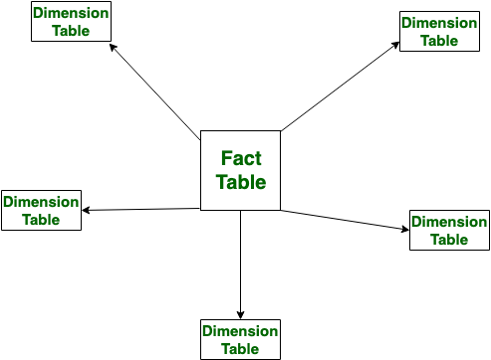
Star Schemas
Definition: Star schema is a data modeling design where a central fact table is connected to multiple dimension tables in a star-like layout.
Fact Table: It contains measurable, quantitative data (e.g., sales, revenue, quantity) and foreign keys linking to dimension tables.
Dimension Tables: These hold descriptive attributes (e.g., Product Name, Customer, Region) that provide context to the facts.
Simplified Queries: Star schema enables simpler and faster queries due to clear relationships and fewer joins.
Improved Performance: As fewer joins are required compared to snowflake schema, performance is optimized in Power BI reports.
Supports Hierarchies: Star schema allows creation of hierarchies (like Year > Quarter > Month) within dimensions for better drill-down in reports.

Slide 63
Relationship vs Merge in Power BI
Feature | Relationship (Power BI Model) | Merge (Power Query Editor)
Definition | Logical connection between two tables in the data model | Joins two tables together into a single query
Where it's used | In Power BI Data Model (after loading data) | In Power Query Editor (before loading data)
Based on | Key columns (e.g., CustomerID) | Key columns, similar to SQL JOINs
Result | Keeps tables separate but allows cross-table analysis | Returns a new combined table or adds columns to a query
Type | One-to-one, one-to-many, many-to-one | Left Join, Inner Join, Right Join, Full Outer, Anti Join, etc.
Impact on reports | Used in DAX, visuals, filters, and slicers | Transforms and reshapes raw data before it's modeled
When to use | When tables are related and used independently in reports | When you want to enrich or flatten data into one query
⚠️ Tip: Use Relationships for dynamic filtering & calculations across tables. Use Merge when you want to combine data into one table before modelling.

Slide 64
Managing relationships
Automatic Detection: Power BI often auto-detects relationships based on matching column names and data types.
Types of Relationships:
Many to one (*:1): The column in one table can have more than one instance of a value, and the other related table, often known as the lookup table, has only one instance of a value
One to one (1:1): The column in one table has only one instance of a particular value, and the other related table has only one instance of a particular value
One to many (1:*): The column in one table has only one instance of a particular value, and the other related table can have more than one instance of a value
Many to many (*:*): Removes requirements for unique values in tables while using composite models
Active vs. Inactive:
Only one active relationship between two tables is allowed at a time.
Inactive relationships can be activated in DAX using USERELATIONSHIP().

Slide 65
Managing relationships
Cross Filter Direction:
Single: Filters flow from one table to another.
Both: Filters flow in both directions (use cautiously to avoid ambiguity).
Cardinality: Defines the nature of the relationship – One-to-One, One-to-Many, etc. Correct cardinality ensures accurate aggregations.
Managing Relationships:
Use Model View to create, delete, or edit relationships.
Click “Manage Relationships” to open a detailed dialog for relationship properties.
Performance and Accuracy:
Avoid circular relationships.
Prefer star schema for fewer, well-defined relationships and better performance.

Slide 66
How to handle Many-to-Many Relationship
Using a Bridge Table –
It contains unique keys from both related tables, establishes one-to-many relationships with each table, helps in aggregating data correctly without duplication.
Create a new table that contains only distinct values of the common key.
Establish one-to-many relationships between the bridge table and the original tables.
Use DAX formulas to aggregate data correctly.
Implementing a Unique Lookup Table –
If your bridge table still results in a many-to-many relationship, ensure:
The key column in the bridge table has no duplicates.
The relationships are set to single-direction filtering to avoid ambiguity.

Slide 67
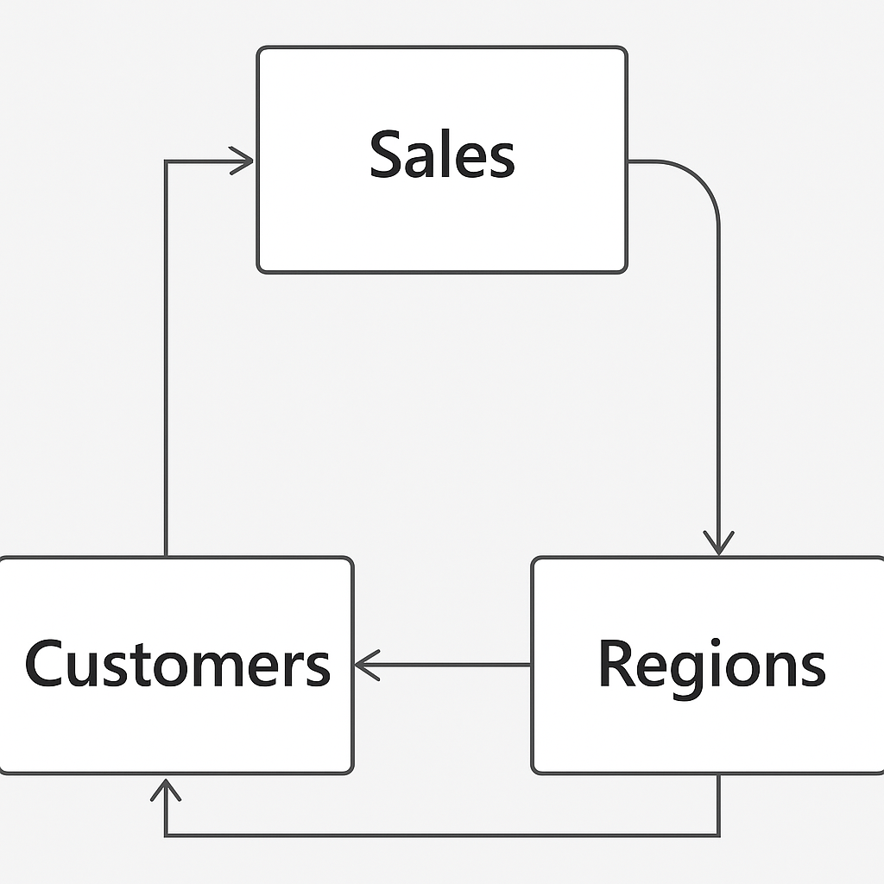
Circular Relationships & Dependencies
Circular Relationships – Occur when multiple tables are connected in a loop, making the relationship path unclear and visuals unreliable.
Example of Circular Relationship – Table 1 → Table 2 → Table 3 → back to Table 1 – This loop creates confusion and performance issues.
Challenges of Circular Relationships
Difficult to trace relationships
Impacts report accuracy
Complicates visual creation
Example – Sales, Customers, and Regions Loop
A Sales table connects to both a Customers and Regions table.
If Customers also links back to Regions, and Regions links to Sales (e.g., for performance reporting), a circular dependency forms.

Slide 68
Circular Relationships & Dependencies – Resolution
Re-evaluate Your Model Design –
Identify if all relationships are truly necessary.
Remove redundant or weak relationships that create the loop.
Use Bridge Tables –
Introduce an intermediate table (like a lookup or dimension table) to break the loop while maintaining relationships.
Use DAX Instead of Relationships –
Instead of a direct relationship, use DAX functions like LOOKUPVALUE, RELATED, or CALCULATE to bring in necessary data.
Change Cross Filter Direction –
Set relationships to single direction if bidirectional filtering causes the loop.
Create Aggregated Tables
Avoid Unnecessary Many-to-Many links.

Slide 69
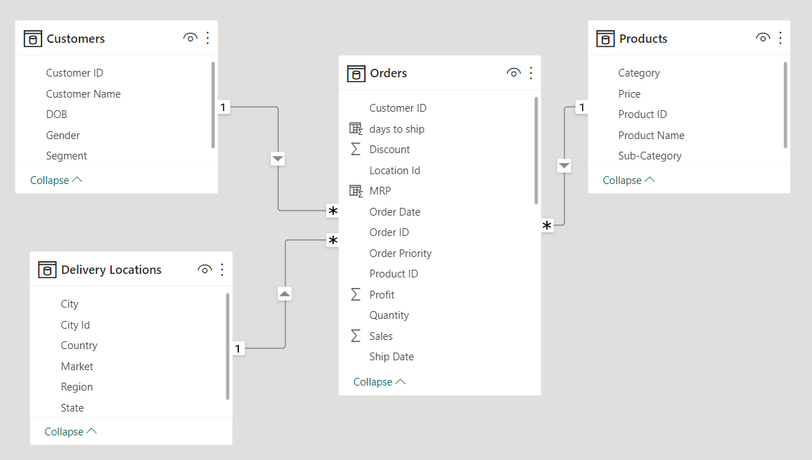
Exercise
Build a data model using Global Superstore Dataset as in the diagram below –

Slide 70
Examples
Ex. Which Market received maximum orders?
Ex. Which month – year showed the lowest Profit?
Ex. Find product subcategory which has negative profit in all the segment with the help of bar chart?
Ex. How many products were returned? What are the total shipping expenses on returned products?

Slide 71
Data Tab

Slide 72
Data Tab
View Imported Data: The Data tab allows you to see the underlying dataset in a tabular format after it's loaded into Power BI.
Inspect and Validate: Users can verify data values, check for missing or incorrect data, and ensure data quality before using it in visuals.
Create Measures and Columns: You can write DAX formulas to create new measures, calculated columns, and quick measures directly from the Data tab.
Field Properties: Modify field names, data types, formatting, and data categories (like geographic fields or dates).
Preview Only – Not Editable: The Data tab doesn’t allow data editing (like Excel), but reflects all transformations done in Power Query.

Slide 73
Data Tab - Toolkit
Create and Edit DAX Calculations – Build measures, calculated columns, and calculated tables using DAX.
Format Fields – Change data type, decimal places, date/time format, currency symbols, etc.
Rename and Reorder Columns – Easily rename fields and adjust their display order in the Fields pane.
View Table Data – Explore and inspect loaded data row by row in tabular format.
Hide/Unhide Fields – Choose which fields to show or hide in the report view.
Sort Data by Column – Define custom sorting (e.g., sort Month Name by Month Number).
Define Hierarchies – Create hierarchies like Year > Quarter > Month for better drill-down visuals.
Set Data Categories – Tag columns as Geography, Web URL, Image URL, etc., for appropriate visual treatment.

Slide 74
Examples
What was maximum discount offered? Which category products were sold with maximum % discount?
Which market received lowest average discount across all customer segments? Consumer segment in African market received ____ % discount?
What is the maximum quantity for a product ordered in a single order? In how many orders, a product was ordered with quantity 2?
What is the % average discount for most profitable product sub-category.
Analyze trends in Sales based in age groups.(Histogram)

Slide 75
DAX Expressions

Slide 76
Introduction to DAX
DAX stands for Data Analysis Expressions.
It is a formula expression language used in Analysis Services, Power BI Desktop, and Power Pivot in Excel.
DAX formulas include functions, operators, and values to perform advanced calculations and queries on data in related tables and columns in tabular data models.
DAX calculation formulas are used in measures, calculated columns, calculated tables, and row filters.
By using Data Analysis Expressions (DAX), you can add three types of calculations to your semantic model:
Calculated tables
Calculated columns
Measures

Slide 77
DAX Data Types
Common Data Types:
Whole Number → 64-bit integer
Decimal Number → 64-bit real (up to 17 digits)
Boolean → TRUE/FALSE
Text → Unicode string
Date → Jan 1, 1900
Currency → High-precision numeric (±9.22×10¹⁴ with 4 decimal places)
BLANK Type:
Represents NULL or empty cell.
Not the same as zero.
Use BLANK() to return BLANK, ISBLANK() to check it.

Slide 78
DAX Operators
Arithmetic Operators: Perform basic mathematical calculations.
+ (Addition)
- (Subtraction)
* (Multiplication)
/ (Division)
^ (Exponent
Logical Operators: Combine expressions to test for multiple conditions. Return TRUE or FALSE.
&& (AND) - TRUE if both expressions are TRUE.
|| (OR) - TRUE if either expression is TRUE.
IN - TRUE if a value exists within a list of values.
Comparison Operators: Compare two values. The result is a logical value (TRUE or FALSE).
= (Equal to)
> (Greater than)
< (Less than)
>= (Greater than or equal to)
<= (Less than or equal to)
<> (Not equal to)
Text Concatenation Operator:
Joins two or more text strings into a single string.
& (Ampersand)

Slide 79
DAX Variables
Benefits of Using Variables:
Improved Readability: Variables make complex formulas easier to understand by breaking them down into smaller, named parts.
Enhanced Performance: When an expression is assigned to a variable, it's evaluated only once, even if the variable is used multiple times in the formula. This can lead to performance improvements, especially for computationally intensive expressions.
Reduced Redundancy: Avoid repeating the same expression multiple times within a formula by assigning it to a variable.
Declaring Variables: Variables are declared using the VAR keyword, followed by the variable name, an equals sign (=), and the expression to be assigned to the variable.
Variables in DAX allow you to store the result of an expression, which can then be referenced multiple times within a single DAX formula.
This can improve readability, performance, and reduce redundancy.
Returning the Result: After declaring one or more variables, you must use the RETURN keyword to specify the result of the DAX formula, which can be one of the declared variables or an expression that uses the variables.
Scope of Variables: Variables have scope only within the DAX formula in which they are declared. They cannot be accessed from other formulas.

Slide 80
DAX Functions
DAX Function | Meaning / Purpose | Example
SUM | Adds all the numbers in a column | SUM(Sales[Amount])
AVERAGE | Returns the average of all the numbers in a column | AVERAGE(Sales[Profit])
MIN | Returns the smallest numeric value in a column | MIN(Products[Price])
MAX | Returns the largest numeric value in a column | MAX(Products[Price])
COUNT | Counts the number of rows in a column that are not blank | COUNT(Orders[OrderID])
COUNTA | Counts the number of values (non-empty) in a column | COUNTA(Customers[Name])
COUNTROWS | Counts the number of rows in a table | COUNTROWS(Sales)
DISTINCTCOUNT | Counts the number of distinct (unique) values in a column | DISTINCTCOUNT(Orders[CustomerID])
CALCULATE | Evaluates an expression in a modified filter context | CALCULATE(SUM(Sales[Amount]), Region[Name] = "West")

Slide 81
DAX Functions
DAX Function | Meaning / Purpose | Example
FILTER | Returns a table that represents a subset of another table | FILTER(Sales, Sales[Amount] > 1000)
ALL | Removes filters from a column or table | CALCULATE(SUM(Sales[Amount]), ALL(Sales))
RELATED | Returns a related value from another table using a relationship | RELATED(Product[Category])
IF | Returns one value if a condition is TRUE, otherwise another | IF(Sales[Amount] > 500, "High", "Low")
SWITCH | Evaluates an expression against a list of values and returns result | SWITCH([Rating], 1, "Poor", 5, "Excellent", "Average")
AND | Returns TRUE if both conditions are true | IF(AND(Sales[Amount] > 500, Sales[Quantity] > 5), "Valid", "Invalid")
OR | Returns TRUE if either condition is true | IF(OR(Sales[Amount] > 500, Sales[Quantity] > 5), "Valid", "Invalid")
NOT | Returns the opposite of a logical value | IF(NOT(Sales[Amount] > 500), "Low", "High")
FORMAT | Formats a value according to a specified format string | FORMAT(Sales[Date], "MMMM YYYY")

Slide 82
DAX Functions
DAX Function | Meaning / Purpose | Example
DIVIDE | Performs division and handles divide-by-zero errors | DIVIDE(Sales[Amount], Sales[Quantity], 0)
VALUES | Returns a one-column table that contains the distinct values from a column | VALUES(Customers[City])
RANKX | Returns the rank of an item in a list, with optional sorting order | RANKX(ALL(Sales[Product]), [Total Sales], , DESC)
ISBLANK | Checks whether a value is blank | IF(ISBLANK(Sales[Discount]), "No Discount", Sales[Discount])
SELECTEDVALUE | Returns the value when a single value is selected, otherwise returns alternate result | SELECTEDVALUE(Products[Category], "All Categories")
NOW | Returns the current date and time | NOW()
Refer for more DAX functions - https://learn.microsoft.com/en-us/dax/dax-function-reference

Slide 83
Measures
Measures are dynamic calculation formulas where the results change depending on context
A formula in a measure can use standard aggregation functions automatically created by using the Auto sum feature, such as COUNT or SUM, or can be defined by the user using the DAX formula bar
Named measures can be passed as an argument to other measures.
The syntax for a measure includes the measure's name preceding the formula

Slide 84
Calculated Columns
A calculated column added to an existing table and then assigned a DAX formula that defines the column's values
Since a calculated column is created in a table in the data model, it is not supported in models that retrieve data exclusively from a relational data source using DirectQuery mode
When a calculated column contains a valid DAX formula, values are calculated for each row as soon as the formula is entered
Values are then stored in the in-memory data model

Slide 85
Difference between Calculated Column and Measure
Feature | Calculated Column | Measure
Definition | Creates a new column in a table using DAX | Calculates a value based on context using DAX
Storage | Physically stored in the data model | Calculated on the fly when used in visuals
Context | Row-by-row (row context) | Filters, slicers, and visuals (filter/context aware)
Use Case | Derive values per row, like Profit = Sales - Cost | Aggregate values, like Total Sales = SUM(Sales)
Performance Impact | Can increase model size if overused | More efficient and optimized for large datasets
Where used | Appears as a column — can be used in slicers, tables, etc. | Appears in values area — used in KPIs, visuals, etc.
Example | Sales[Profit] = Sales[Revenue] - Sales[Cost] | TotalRevenue = SUM(Sales[Revenue])
⚠️ Tip: Use Calculated Columns when you need to create new fields per row. Use Measures for aggregations and summarizations in visuals.

Slide 86
Calculated Column – PQE vs DAX
Scenario | Recommended Tool | Reason
Data cleaning or reshaping | PQE | Faster, static, cleaner
Static column (e.g., split names, extract year) | PQE | One-time transform
Dependent on filters/slicers | DAX | Reacts to user interaction
Aggregation across relationships | DAX | Uses filter and row context
Reduce model size | PQE | Pre-process outside of the model

Slide 87
Examples
Ex. Calculate sales on order id by applying 18% GST, then present the sales figures categorized by Indian states.
Ex. Display avg time(days) to complete an order. HINT - Calculate the no of days required to ship each transaction.
Ex. Calculate Gross Sales as Quantity * Price.
Disadvantage in using PQE
Using Related()

Slide 88
Date Table
Date tables in Power BI are tables that only contain date-related data.
It is a standard dimension table that can be used to reference dates in your model and analyze data based on these dates.
They are also useful for time intelligence calculations and when creating reports that require precise date information.
Date tables allow you to slice and dice your data by date attributes such as weekday, month, quarter, and year.
They also allow you to use DAX time intelligence functions that can be used to generate Fiscal year calculations

Slide 89
Date Table
A date table is a table that meets the following requirements:
It must have a column of data type date (or date/time)—known as the date column.
The date column must contain unique values.
The date column must not contain BLANKs.
The date column must not have any missing dates.
The date column must span full years. A year isn't necessarily a calendar year (January-December).
The date table must be marked as a date table.

Slide 90
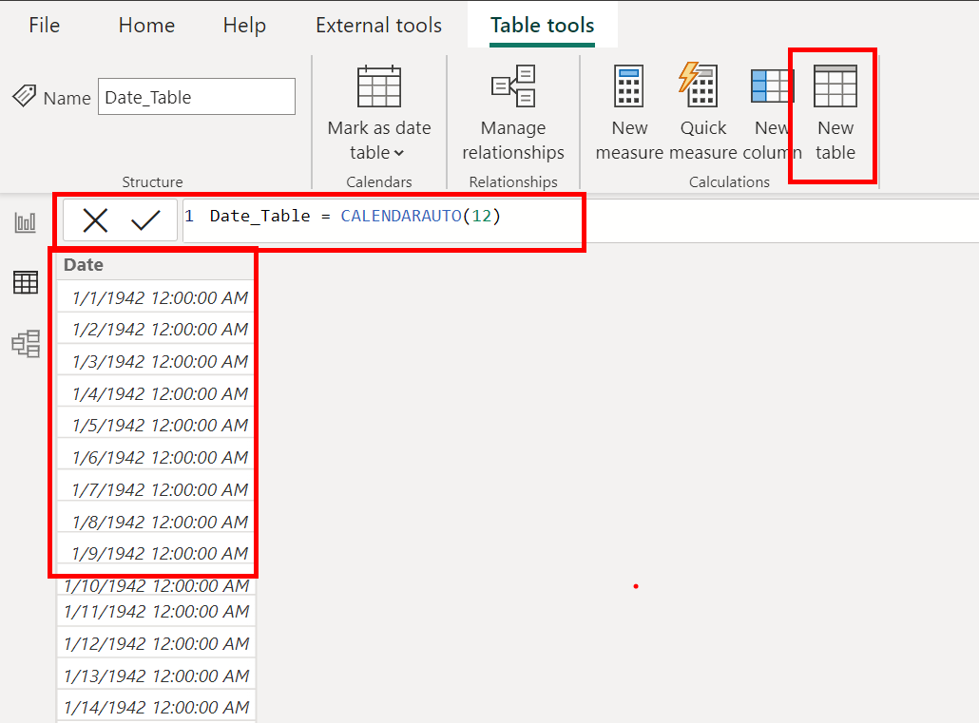
Exercise – Create a Date Table
Click on New Table in Data Tab
Use function calendarauto()
It will generate a range of dates

Slide 91
Exercise
Example – Use Invoices Dataset
Load data from invoices.xlsx
Create a dedicated Date table for time-based analysis
Creating Date Table, adding FY year | month | quarter
Establish a relationship between the Invoices table and the Date table
Handle in-active relationship using – userelationship()
Use DAX to split the Invoices table into Sales Details and Payment Details tables

Slide 92
Knowledge Check
Q. You're using Power BI Desktop to develop a model. It has a table named Sales, which includes a column named CustomerKey. In reports, you need a calculation to show the number of different customers who have placed orders. What type of DAX calculation do you add to the model?
Calculated table
Calculated column
Measure

Slide 93
Knowledge Check
Q. You're using Power BI Desktop to develop a model. It has a table named Customer, which includes a column named DateOfBirth. In reports, you need to group customers by current age. What type of DAX calculation will you add to the Customer table?
Calculated table
Calculated column
Measure

Slide 94
Knowledge Check
Q. You write a DAX formula that adds BLANK to the number 20. What is the result?
The result is zero (0).
The result is 20.
The result is BLANK.

Slide 95
Knowledge Check
Q. You're using Power BI Desktop to develop a model. It has a table named Geography, which has two relationships to the Sales table. One relationship filters by customer region and the other filters by sales region. You need to create a role-playing dimension so that both filters are possible. What type of DAX calculation do you add to the model?
Calculated table
Calculated column
Measure

Slide 96
Visualize data in Power BI

Slide 97
Power BI Report View
What is Report View?
The Report View is the main design workspace in Power BI Desktop where you create and arrange your visualizations (charts, tables, maps, etc.).
It appears as the middle icon (a bar chart symbol) in the left vertical pane.
Here you build the interactive report pages seen by end users.
Key Components on Report View:
Canvas: The large white area where visuals are placed and arranged.
Visualizations Pane: Contains all chart types and visual elements you can add.
Fields Pane: Shows tables and fields from your dataset, drag to add to visuals.
Filters Pane: To apply filters at visual, page, or report level.

Slide 98
Adding and Customizing Visualizations
How to add visuals:
Click any visualization icon (e.g., clustered bar chart, pie chart, line chart) in the Visualizations pane.
The visual placeholder appears on the canvas.
Drag fields from the Fields pane into the appropriate visual fields (e.g., Axis, Legend, Values).
Customizing visuals:
Use the Format pane (paint roller icon) to change colors, fonts, labels, titles, background, borders, and more.
Example: Change the bar colors to match corporate branding or add data labels for clarity.
Resize and reposition visuals by dragging edges or moving them on the canvas.

Slide 99
Using Filters and Slicers
Filters Pane:
Apply Visual-level filters to restrict data for a single visual.
Use Page-level filters to affect all visuals on the current page.
Use Report-level filters to apply across all report pages.
Slicers:
Add slicers from the Visualizations pane to create interactive filters users can manipulate.
Example: Add a slicer on "Year" so users can dynamically select the year to view.
Customize slicer style (dropdown, list, between values) in the Format pane.
Best Practice:
Use filters and slicers thoughtfully to give users control without overwhelming the report.

Slide 100
Bookmarks and Navigation for Interactive Reports
Bookmarks:
Bookmarks capture the current state of the report page — including filters, slicers, and visual settings.
Use bookmarks to create report stories, snapshots, or toggle views.
Example: Save a bookmark showing "Top 10 customers" or "Current month sales."
Buttons and Images for Navigation:
Insert Buttons (Home, Back, Reset, etc.) or Images via the Insert menu.
Assign Bookmark actions or Page navigation actions to these buttons/images.
This enables users to jump between views or pages smoothly, making the report more interactive.
Example:
Create a "Home" button that returns users to the main dashboard page.

Slide 101
Enhancing User Experience with Visual Elements
Using Images and Shapes:
Insert logos, icons, or shapes to brand your report and improve aesthetics.
Images can also act as clickable buttons with assigned actions.
Custom Buttons:
Create custom navigation buttons and assign actions like:
Bookmark: Show/hide visuals or toggle filters.
Page Navigation: Move to other report pages.
Web URL: Link to external websites or documents.

Slide 102
Better User Experience
Keep navigation intuitive and consistent
Use clearly labeled buttons (e.g., “Home”, “Back”) and maintain their position across pages.
Use tooltips and button text to guide users
Enable tooltips for visuals and navigation elements to help users understand purpose without clutter.
Combine bookmarks and buttons
Create interactive reports where users can toggle views (e.g., show/hide visuals or switch between summaries and details).
Avoid clutter – less is more
Show only essential visuals on a page. Use bookmarks or drillthroughs to display more when needed.
Group and align visuals properly
Use the alignment tools to maintain visual consistency and a professional layout.
Use slicers for key filters
Empower users with slicers for commonly changed filters like date, region, or product category.
Use themes and color schemes wisely
Apply consistent color palettes (match brand guidelines) to improve readability and aesthetics.
Add a 'Reset Filters' or 'Clear Selection' button
Use bookmarks to return all slicers and filters to their default state, making exploration easier.

Slide 103
Examples
Create a dynamic conversion measure to display Sales in INR, using a parameter that allows users to set the exchange rate.
Identify the product within the Furniture category that has the highest ratio of Shipping Cost to Sales.
Estimate 2020 Sales for the Home Office segment, assuming a 10% year-over-year growth from 2019 across all customer segments.
Calculate and display the number of on-time vs. late deliveries(days to ship > 6) and show their distribution as a percentage of the grand total.
A country is considered “Performing” if its total profit exceeds ₹10,000.
Classify countries as Performing or Non-Performing.
Count and display both groups as a percentage of the grand total.
Note: Emphasize the difference between using a calculated column vs. a measure for this task.
Explore Gradient, Rules and Fields in conditional formatting for a map chart – use of measure
Ex. Using a gauge chart display the target are achieved or not achieved for construction dataset. Use Red-Amber-Green colour coding.

Slide 104
Examples
Create a DAX measure to calculate Month-over-Month changes (MoM%) Sales based on Order Date. Explore icons under conditional formatting. For more examples see, DAX Time Intelligence Functions
Ex. What were the total sales generated by products in the Technology category by the end of 2018?
Ex. Display average sales across product subcategories using a column chart. Add an average line using the Analytics pane. Further, calculate the overall average sales and add it as a constant line. Compare the difference between subcategory and overall averages.
Ex. Plot a line chart showing average sales over months. Add another line for the category average. Apply subcategory filters to compare individual subcategory trends with the category average. This mirrors the scenario of comparing a mutual fund's NAV trend with its category average.
Ex. Display average sales across product categories using a column chart. Calculate category-level average sales and add it as a constant line. Include a Market slicer for further filtering.

Slide 105
Examples
Ex. Display the top 10 products from each product category. Explore the difference between using the Filter pane and using RANKX() for this purpose.
Ex. Customer Attrition – Count the number of customers who placed their last order in each year.
Ex. Use bookmarks to conditionally display different charts.
Ex. Dynamically update the page title based on the Market selected in the filter.

Slide 106
ALL(), ALLEXCEPT(), and ALLSELECTED(
Function | Description | Typical Use Case
ALL() | Removes all filters from a table/column | Ignore slicers/filters to get grand total
ALLEXCEPT() | Removes all filters except specified column(s) | Keep one context (e.g., customer) and remove rest
ALLSELECTED() | Removes filters except those applied by user selection (slicers/UI) | Calculate totals within visual/slicer filters
Tip: Use ALL() for fixed benchmarks, ALLEXCEPT() for grouped rollups, and ALLSELECTED() when working with slicer-based filters or visual interactivity.

Slide 107
Conditional Visibility
The navigation bar and bookmark navigator visuals in Power BI do not support conditional formatting or visibility logic like standard buttons do.
These navigators are static and auto-generated and are meant to display all pages or bookmarks, regardless of slicer values or DAX measures.
Where Conditional Visibility Does Work
Conditional formatting (like showing/hiding based on a measure) only works with:
Individual buttons (Insert → Buttons → Blank / Left Arrow / etc.)
Shapes
Images
Text boxes (limited)

